Slide 1















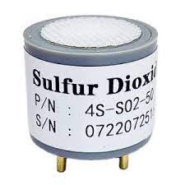










Classic WMS – Technical Architecture
OAuth2 Resource Server
Server-Side Components
OAuth2 Token
Microservice Services
Data Access Layer
MS SQL, NOSQL DB
Client Apps
Identity Provider
Dashboard Service
Order Processing Service
Inbound / outbound Service
Make and Change Service
Stock Count Service
Reports Service
Device Data Processing Service
Request
Mongo DB
HTTPS
JSON
Response
API Gateway
MSSQL Server DB
Device Data Processing Engine
Data Pre-processing
GPS
Sulfur Dioxide
Data Feed
Device
Data Storage
Narcotic
Gas
Smart Cam
Device
Feed
Internet Gateway
Ingestion Service
Data Acquisition
Data Aggregation
IoT Smart Sensors

